Slide 1
OWASP - Central Pennsylvania
Chapter Leaders - Nathan Cooper and Joe Oriel

Slide 2

Admin notes
Restrooms
Snacks, Beverages – Please dispose of your trash
Emergency Exits
5-10min break every 30 – 40 minutes

Slide 3
Today’s Agenda
OWASP Membership -- OWASP Email list -- OWASP-Info
Intro’s – Group
Name
Interest
Expectations
Phishing
Information

Slide 4
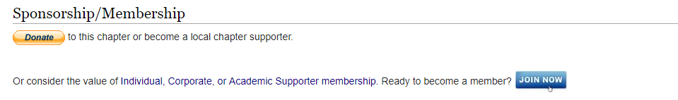
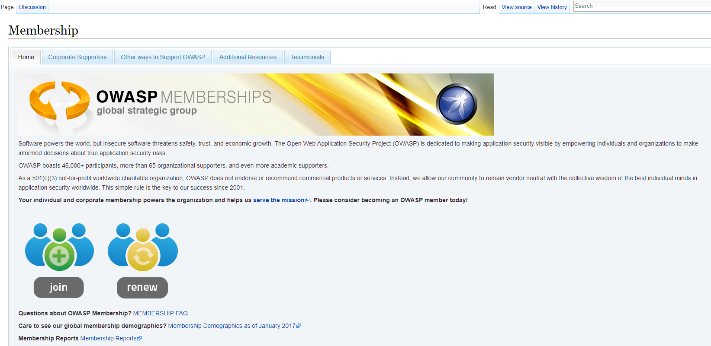
OWASP Membership
Central PA Chapter
Membership

Slide 5
OWASP EMAIL - SLACK
Sign Up - Email
SLACK –CentralPA-OWASP

Slide 6
OWASP - INFO
OWASP Serverless Top 10 Project -
Cody who leads Hacker One’s “Hacker 101” (https://www.hackerone.com/hacker101) CTF platform and volunteered to coordinate with us for an online OWASP / WIA CTF on International Women’s Day (Friday, March 8).
Open Source application security tools
https://www.owasp.org/index.php/Free_for_Open_Source_Application_Security_Tools
https://www.owasp.org/index.php/Source_Code_Analysis_Tools - i.e., SAST
https://www.owasp.org/index.php/Category:Vulnerability_Scanning_Tools - i.e., DAST
https://www.owasp.org/index.php/Software_Composition_Analysis - i.e., SCA (This one is a NEW DRAFT being developed by Steve Springett)
OWASP YOUTUBE Channel

Slide 7

OSCP or CTF
OSCP is the most well-recognized and respected certification for info security professionals
To become certified, you must complete Offensive Security’s Penetration Testing with Kali Linux (PwK) course and pass the 24-hour hands-on exam
An OSCP has mastered a comprehensive and practical understanding of the penetration testing process
For hands-on experience, each student receives access to a virtual penetration testing lab where techniques learned within the course can be practiced
Notes:
Meetings how often – how long? – Who is willing to teach/share something?
Circle 3 that you are most interested in

Slide 8
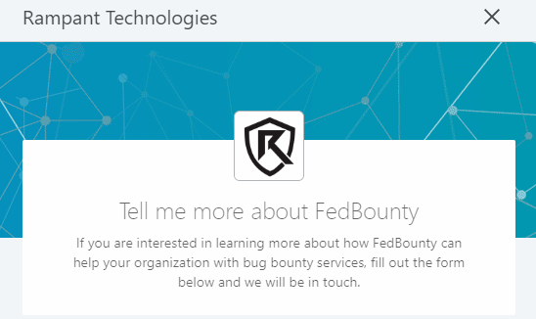
Bug Bounty
Notes:
Meetings how often – how long? – Who is willing to teach/share something?
Circle 3 that you are most interested in

Slide 9
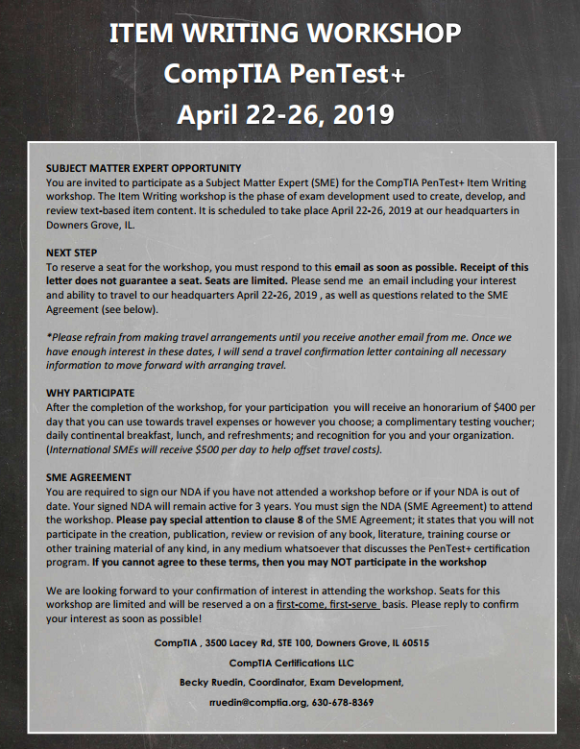
Pentest+
Our next PenTest+ Item Writing Workshop is April 22-26. If you are interested in attending, please respond by February 8th with your interest, and please note that seats are limited and often fill quickly. Receipt of this email does not guarantee a seat.

Slide 10
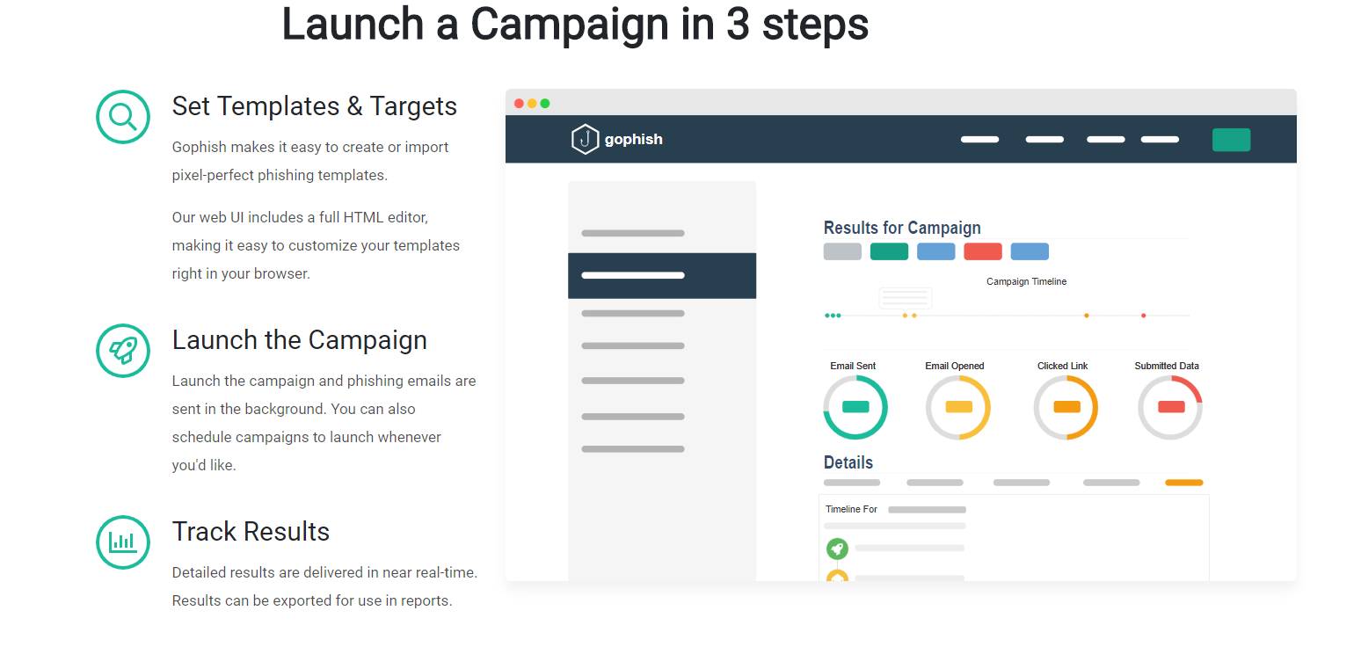

Phishing
GOPhish
SET toolkit
Notes:
Do you do friendly phishing
Do you use it as training or a measurement
Are you using a tool or built your own solution?

Slide 11
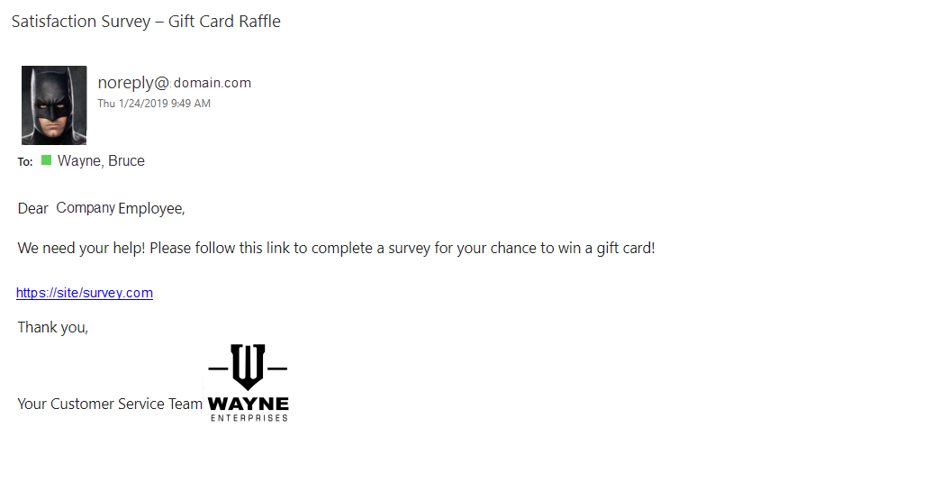
Phishing
Notes:
Do you do friendly phishing
Do you use it as training or a measurement
Are you using a tool or built your own solution?

Slide 12
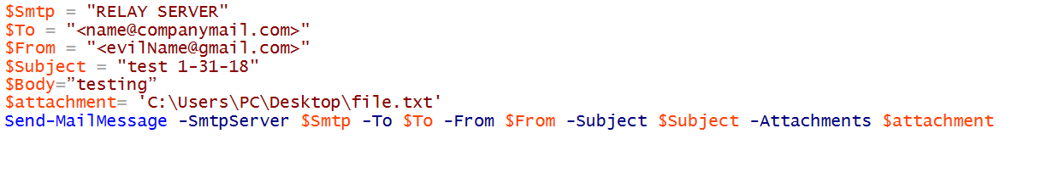
Phishing – simple
Notes:
Do you do friendly phishing
Do you use it as training or a measurement
Are you using a tool or built your own solution?

Slide 13
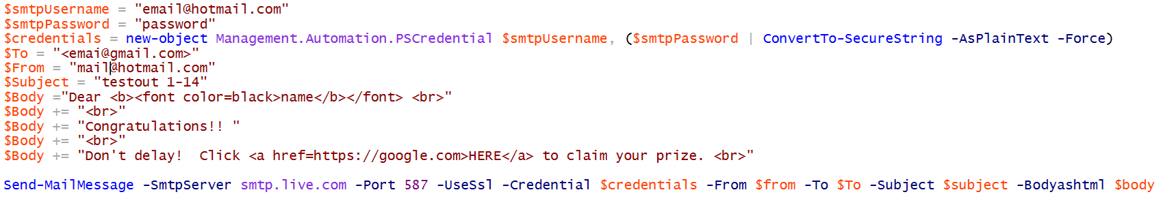
Phishing – hotmail
Notes:
Do you do friendly phishing
Do you use it as training or a measurement
Are you using a tool or built your own solution?

Slide 14
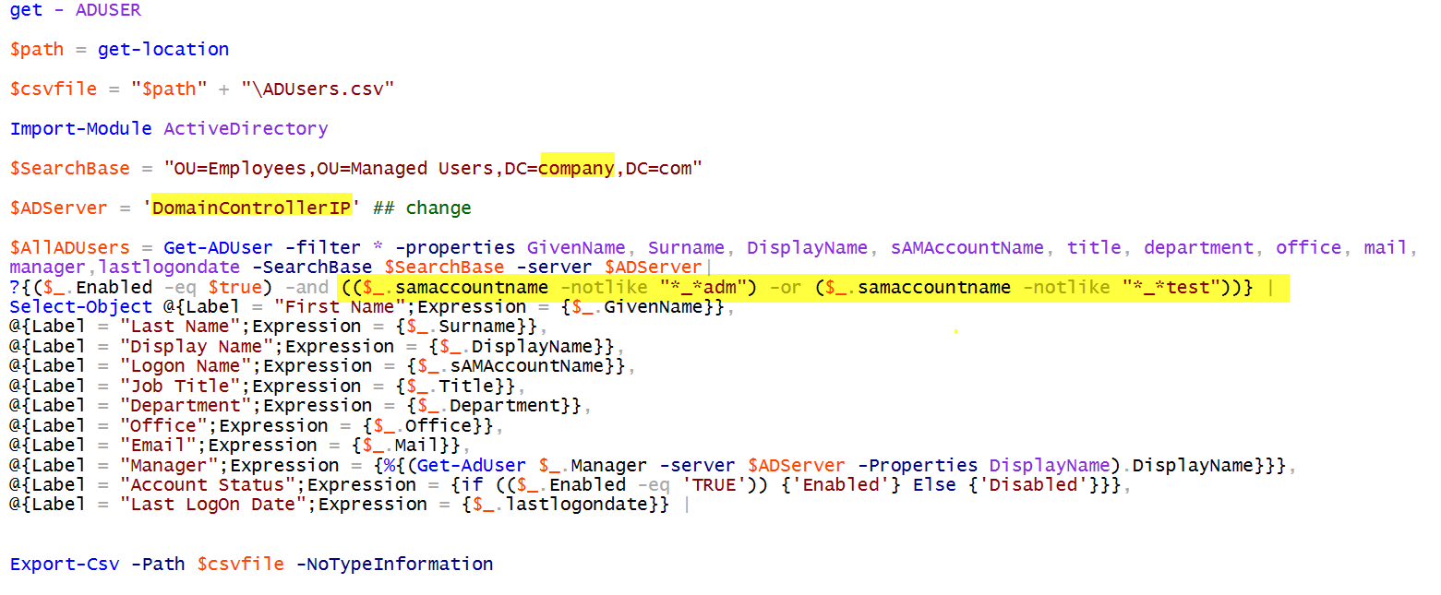
Phishing – get user list
Notes:
Do you do friendly phishing
Do you use it as training or a measurement
Are you using a tool or built your own solution?

Slide 15
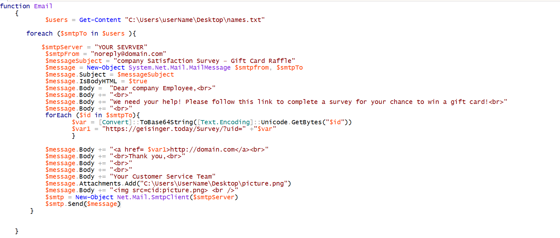
Phishing – EMAIL
Notes:
Do you do friendly phishing
Do you use it as training or a measurement
Are you using a tool or built your own solution?

Slide 16
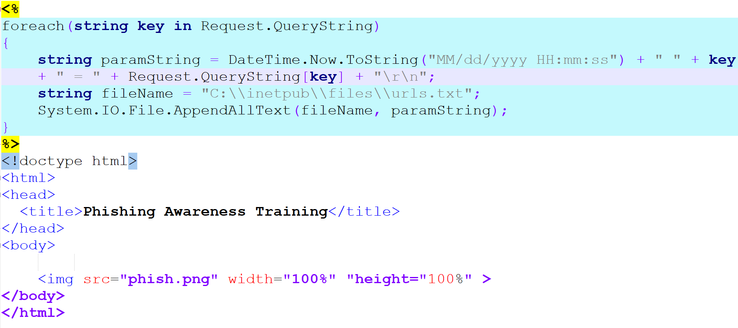
Phishing – website aspx
Notes:
Do you do friendly phishing
Do you use it as training or a measurement
Are you using a tool or built your own solution?

Slide 17
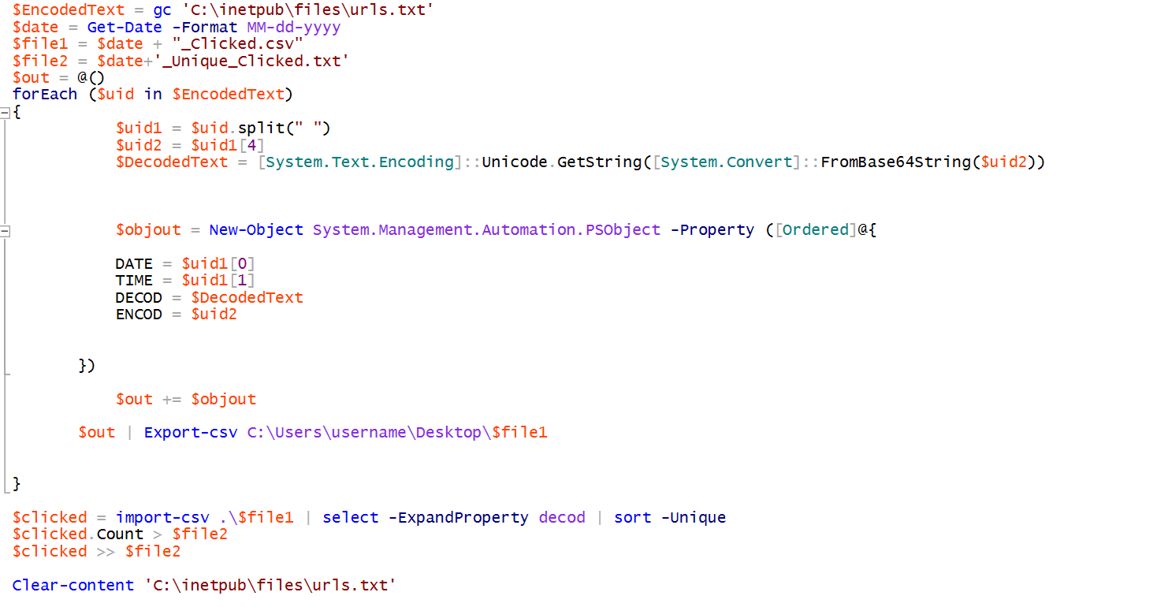
Phishing – Decode
Notes:
Do you do friendly phishing
Do you use it as training or a measurement
Are you using a tool or built your own solution?

Slide 18
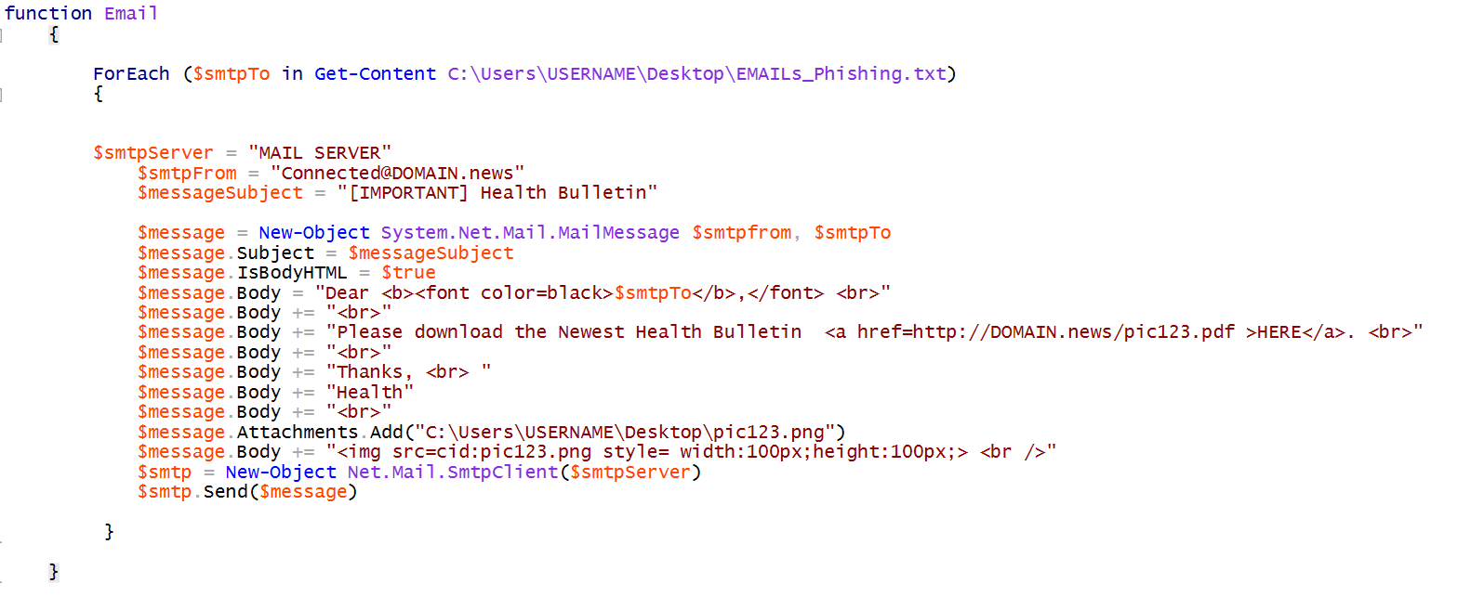
Phishing – add username
Notes:
Do you do friendly phishing
Do you use it as training or a measurement
Are you using a tool or built your own solution?

Slide 19
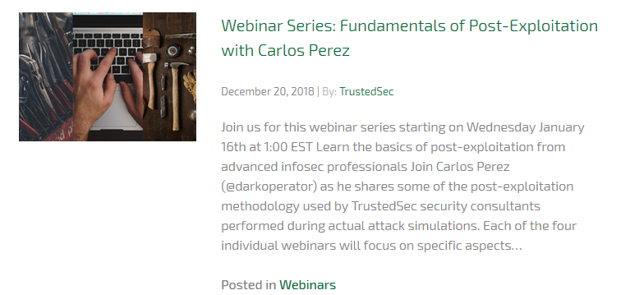
Webinar
TrustedSec -

Slide 20
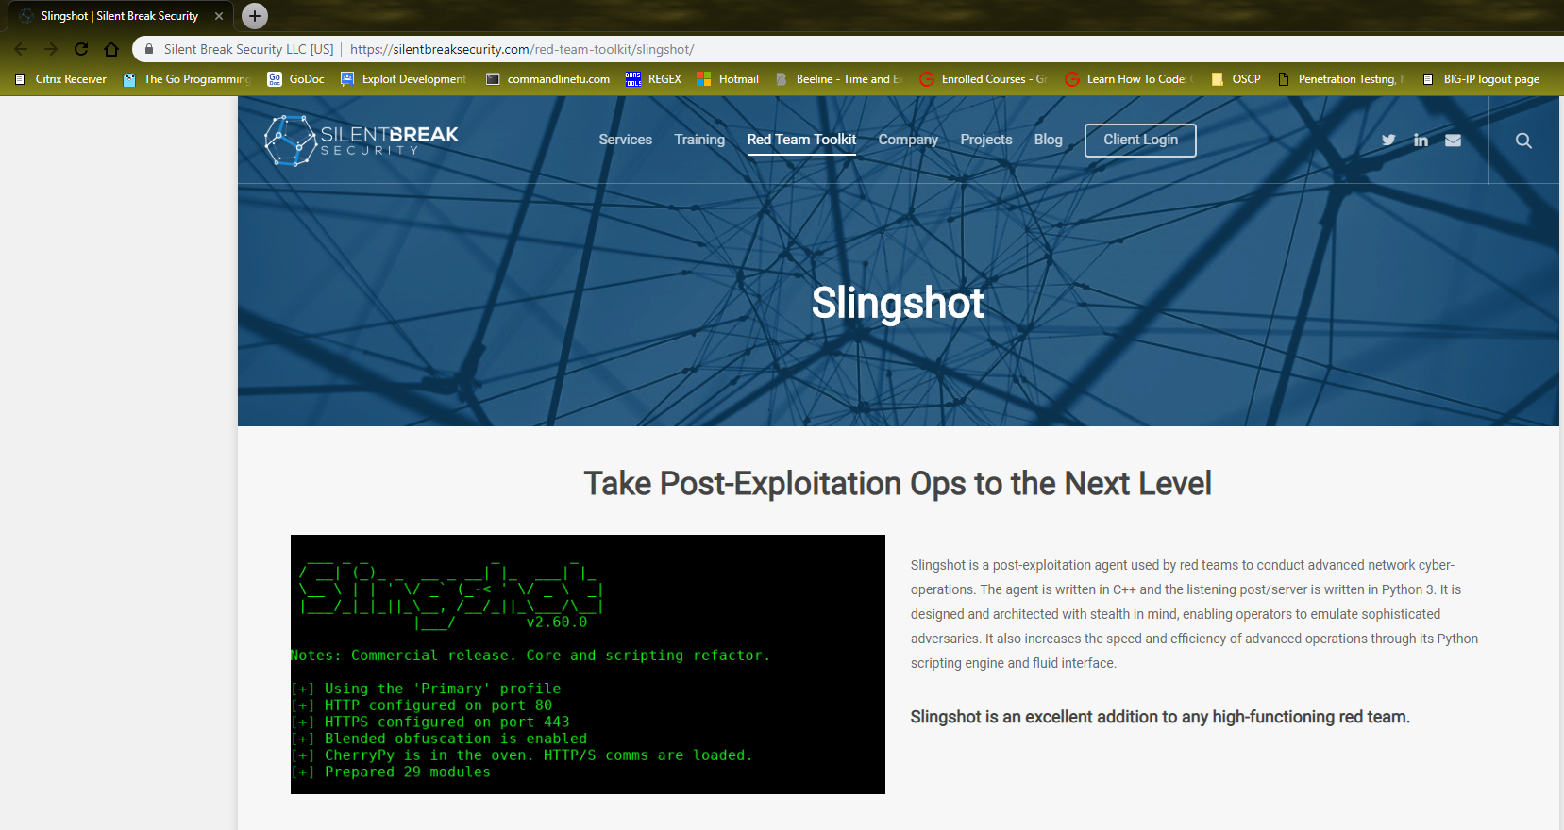
Tool - Slingshot
Silent Break Security -

Slide 21
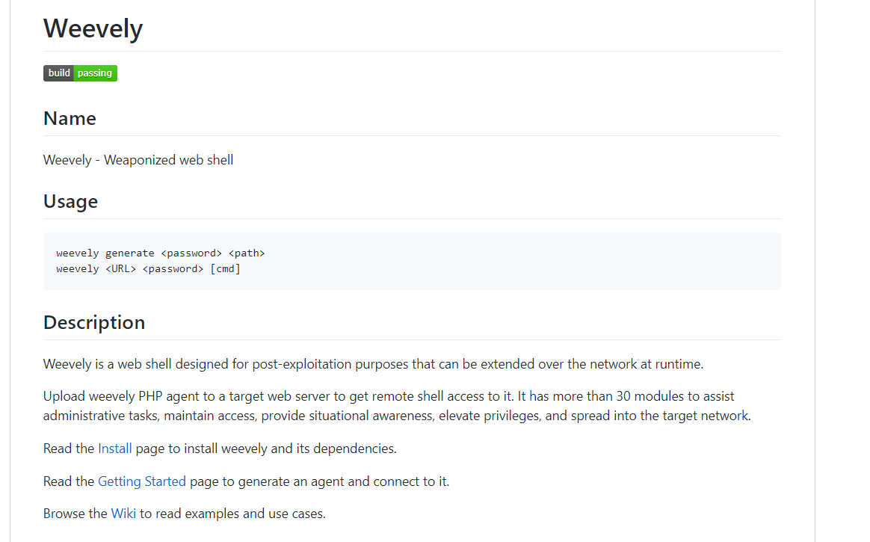
Tool - weevely
epinna/weevely3 - - https://github.com/epinna/weevely3

Slide 22
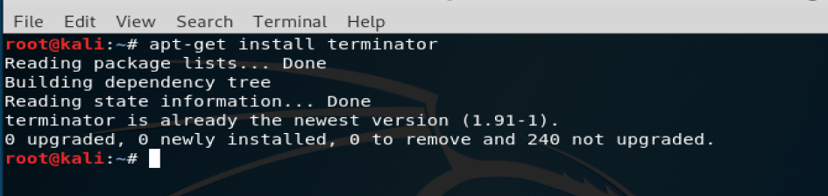
Tool - terminator
Terminator

Slide 23
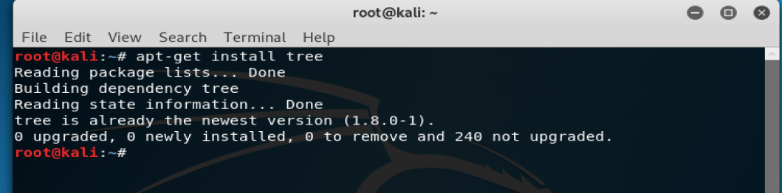
Tool - Tree

Slide 24
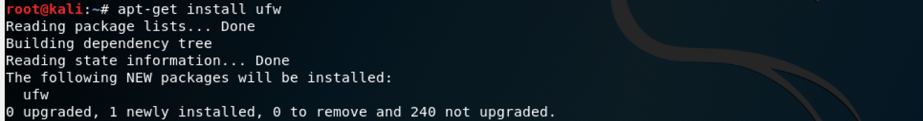
Tool - UFW
Uncomplicated Firewall (UFW)

Slide 25
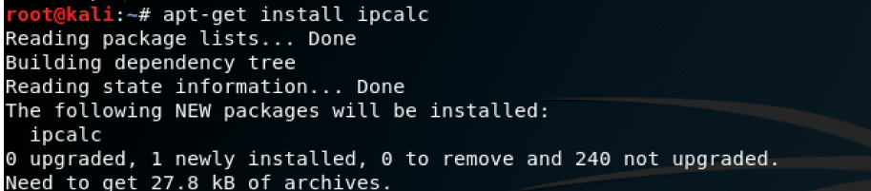
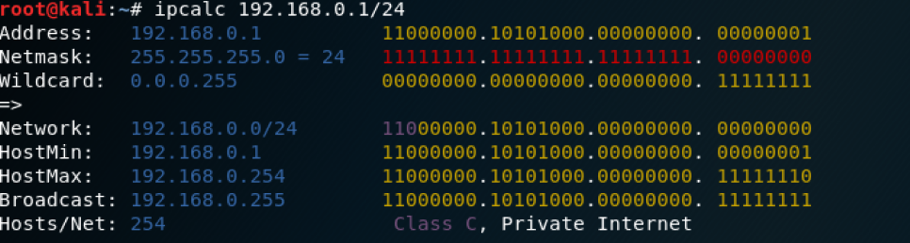
Tool– IPcalc

Slide 26
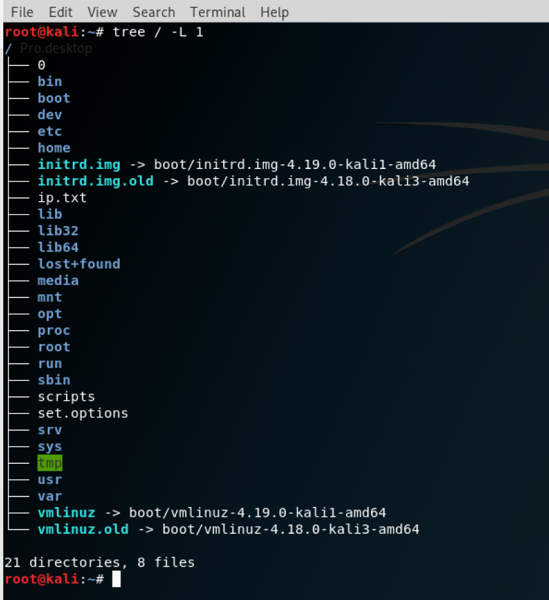
OWASP INFO – Home Work
Figure out what is stored in each of the directories
Where do you normally install optional tools you download that are not added to your path?
Where are users stored on the system
Linux WARGAMES

Slide 27
OWASP INFO - Home Work
How do you find a file
How do you locate a file
Show where a file is installed
Clear the screen
Start a program and background the process
Search your command history
Show processes
Find a pid
Kill a process
Start – stop a service
Show system resources
Add user
Give user sudo permissions
Delete user
Reboot the system
Unzip a file zip, tar
Linux – Commands:
Show current directory
Change directory
List files
List files and hidden files
Show files size in human readable format
How do you install a tool
How search the repository for a tool
How do you download a file
How do you create a file
How do you edit the file
How do you install a package
How do you copy a file
How do you move a file
How do you rename a file
How do you change file permissions
How do you show history
How do you show the last 10 lines of a log file

Slide 28
Contact
Nathan Cooper – Linkedin
Nathan.cooper@owasp.org
Joe Oriel – Linkedin
Joe.oriel@owasp.org
Slides

